Slide 1
Distributed Hash Table
(Implementation Focused)
Team: SCHRODINGER
Xuzheng Lu: (G34363475)
Xiaoyu Shen: (G33150730)
Zetian Zheng: (G36558368)
Guanyuan Shen: (G48268794)

Slide 2
Contents
Product Introduction
Related Work
Approaches
Product Demo
Summary

Slide 3
Product Introduction

Slide 4
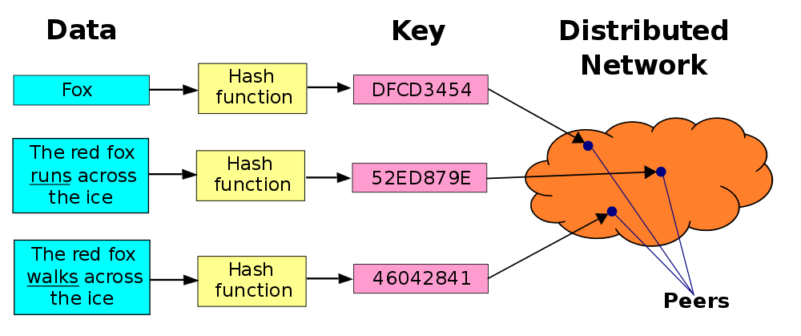
Product Introduction
Product Introduction
DHT is a protocol for structured peer-to-peer networks.
Maintain a huge file index hash table.
DHT entries: (key, value) pairs.
Key is hash value of the ficle.
Value is the IP address.
Notes:
A distributed hash table (DHT) is a protocol for structured peer-to-peer (p2p) networks used. Each node in the network follows a specific rule to divide and store the large file index hash table.
"peer to peer" means that the function of each node is equal, and each node is connected with others via the internet. In this network, files are transported between nodes. the most important feature for peer to peer is to efficiently locate data items
The DHT entries should be the form: (key, value) pairs. The key is the hash value of the file, and the value is the IP address where the file is stored.
In this graph, the data from left side has been translate by hash function to the key. and then it stores in the peers node in distributed network. Follow this rules, we can easily to find and return value/address from the query node.
In this project, we implement a DHT system to store the keys

Slide 5
Why we choose Distributed Hash Table?
Product Introduction
 | Advantages | Limatation | Examples
Decentralized System | Minimal problem of performance bottlenecks occurring High availability More autonomy and control over resources | Difficult to achieve global big tasks No regulatory oversight Difficult to know which node failed Difficult to know which node responded | Bitcoins
Centralkized System | Low latency than centralized system | Difficult to achieve consensus Conventional way of logging events by absolute time they occur is not possible here | Google search system

Slide 6
Related Work

Slide 7
Related Work
Chord DHT
the entire network is a ring, and each data is stored by key.
Pastry DHT
Ring network topology like chord but not directly use node hash values to construct a ring
Tapestry DHT
Tree topology in this network, and data is saved on the node closest to the key value of the data

Slide 8
Approaches

Slide 9
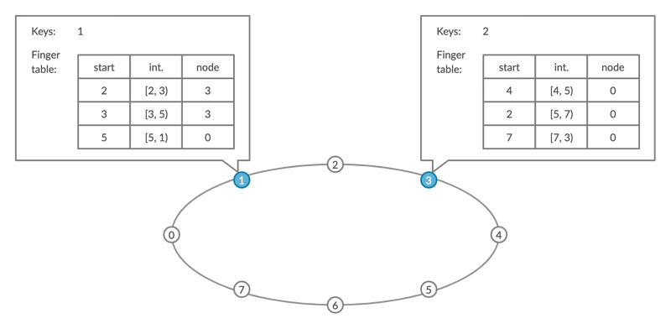
The Structure of Chord-based System
Approaches
NID(Node Identifier)
KID(Key identifier)
Chord Ring
Finger Table
RPC(GRPC)
Notes:
1 min
thanks for guanyuan’s introduction, I will introduce the chord system
Here is structure graph of chord,
In this graph we have some important components:
first, NID and KID are getted by SHA 1 which is a hash algorithm from IP address of node machine and files.
they are allocated on a chord ring for key distribution, node distribution, and key location.
The key is allocated to the node with NID>=KID.
and in the chord ring, the nodes are placed on it from large to small by NID in the clockwise direction
then the Finger table:
it contains up to m entries, each entry points to one node, and each node holds more information about their closest nodes.
and for all the nodes, we use GRPC service as our connections.
Then I will introduce funcitons design.

Slide 10
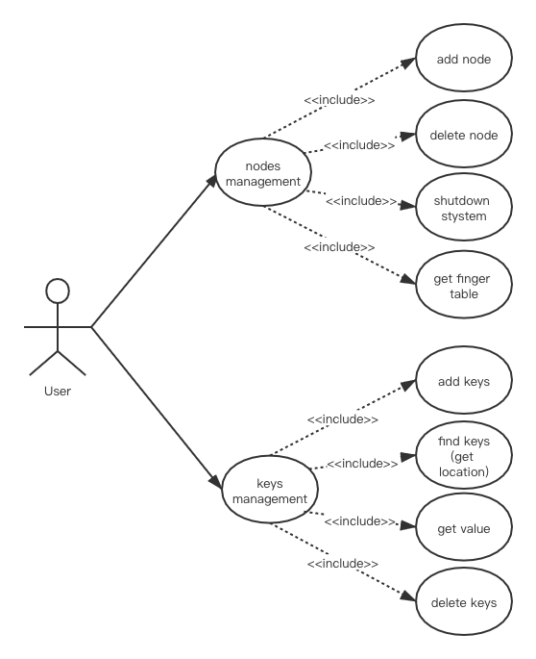
Main Functions
Approaches
manage nodes
add node
delete node
get finger table
shut down system
manage keys
add keys
find keys (get location)
get value
delete keys
node stabilization
Notes:
20s
here is our functions design
in our system, there are three major parts: nodes management, keys management and node stabilization
the user can control these models to do the actions in this list.
and then let me introduce you some core functions of the chord system.

Slide 11
Find Keys (get location)
Approaches
Pass the query to the closest successor or predecessor
Find the k with the "largest" one on the circle whose node ID is smaller than k
Until a node finds out the key is stored in its immediate successor.
Notes:
30s
The first one is Find keys or get location
in this function
the node pass the query to the closest successor or check the finger table to its predecessor
then it find the k with the "largest" one on the circle whose ID is smaller than k
we repeat these process until a node finds out the key that stored in its immediate successor.
the time cost is O(logN), N is the number of machines in this ring.

Slide 12
Add Node
Approaches
After node join, three invariants update
successor of each node
keys
finger table
Tasks need to be done
Initialization
Notify other nodes
new node takes over keys form its successor
Notes:
36 s
another core function is Add new nodes
after node join, 3 objects update
first each node's successor points to its immediate successor correctly
second, each key is stored in successor(k)
and each node's finger table should be correct.
and also some tasks need to be done
firstly to Initialize node n
it will Notify other nodes to update their predecessors and finger tables.
then, The new node takes over its responsible keys from its successor.

Slide 13
Stabilization
Approaches
Stabilize()
Inform()
findNextFinger()
CheckPreNode()
Notes:
40s
to ensure the reliability of our system, all nodes need to automatically update their status,
therefore, this stabilization function is running periodically in the background.
some functions are:
Stabilize(): in this function, node n check its successor’s predcessor
Inform(): which notifies node n‘s successor of its existence, and change its predecessor to n
findNextFinger(): which updates finger tables
checkPreNode(): Periodically checks if its’ predecessor is alive

Slide 14
Challenges
Approaches
Autonomy and decentralization
load balance
Fault tolerance
Scalability
Notes:
1.5 min
except challenges we mentioned before, we still have these challenges, all we have a good design to solve them.
the first chanllenge we meet is Autonomy and decentralization:
In our design, our system has no central coordination
and For each node server in our project, the node responsible for the object can be reachable through a short routing path.
and our system are well load balance because of chord ring design.
the third one is Fault tolerance:
In this project, we used channel to send message between nodes. when one node shutdown accidentally, the channel will notify the predecessor and successor of this node that shutdown and safely exit.
the last one is Scalability:
For this problem, Our product is able to handle a growing amount of nodes be added to the current system. as design methods which showed before in Add nodes :
our project
make sure finger tables for each nodes are correctly.
each key stored correctly
the successor correctly point to its’ predecessor.
therefore, our system can extend safely.

Slide 15
Product Demo
Notes:
and then, my teammate Xuzheng and Xiaoyu will present our project Demo and code part.

Slide 16
Summary

Slide 17
Impact
Summary
Single point of failure (SPOF)
BroadCast Storm
FIles Store
Notes:
30 s
Here are overall impacts of our design,
The design of DHT firstly solved Single point of failure (spof) for the centralized system like napster.
In our design, we don’t have a central node to occur SPOF problem. and we use GRPC and channels to ensure the connections between nodes.
then, the BroadCast Storm is the accumulation of broadcast and multicast traffic on a structured p2p system.
Chord system avoid this porblem by efficiently searching and storing keys in the chord ring.
and last is Files store, compare traditional
in our product each node only maintain partial files and these files are well balanced in whole system.

Slide 18
Summary
Chord DHT implementation
User interface implementation
Chanllegens we solved:
Fault tolerant
Scalability
Decentralization
Autonomy
Notes:
To conclude, we implemented a DHT system, and we designed the user interface for management for the nodes and keys.
We also solved the challenges of the DHT system.

Slide 19
Future Work
Summary
Initialization fault tolerance
Solve RPC deadline exceeded errors
Test on clusters
Notes:
In the future, we wanna bring the initialization fault tolerance to the system so that we don’t need to wait for nodes to initialize.
Also, RPC deadline exceeded errors should be solved.
So far our testing is performed locally, and in the future we can test our system on clusters.

Slide 20
Thank you!

